Slide 1
A Query-by-Singing System based on Dynamic Programming
Author : Jyh-Shing Roger Jang, Ming-Yang Gao
Professor : 陳嘉平
Reporter : 楊治鏞

Slide 2
Outline
Introduction
Related Work
CBMR system
Performance Evaluation
Conclusions and Future Work

Slide 3
Introduction
The system, known as CBMR (Content-Based Music Retrieval), facilitates the content-based song database retrieval via users' acoustic inputs.
This paper presents a query-by-singing system that is based on two levels of dynamic programming as its comparison engine.

Slide 4
Related Work
Query by humming by Ghias,Loga and Chamberlin in 1995
- Sing ‘la’ or ‘ta’ when transposition
- U (up, meaning this note is higher than the previous one)
- R (repeat, meaning this note is the same as the previous one),
- D (down, meaning this note is lower than the previous one).

Slide 5
CBMR system
Songs Database
Midi message
Extraction
Microphone
Signal input
Pitch
Tracking
Pitch
Smoothing
Dynamic
Time Warping
Query
results

Slide 6
Input Collection
The acoustic input is recorded from a PC microphone directly with a length of 8 seconds, sample rate of 11025, 8 bit resolution and single channel (mono).

Slide 7
Pitch Tracking
The acoustic input is first put into frames of 512 points, with 340 points of overlap; this corresponds to 1/64 second for each pitch frequency.
Then every 4 pitch frequencies are averaged to merge into a single frequency, thus the final pitch vector has a time scale of 1/16 second.

Slide 8
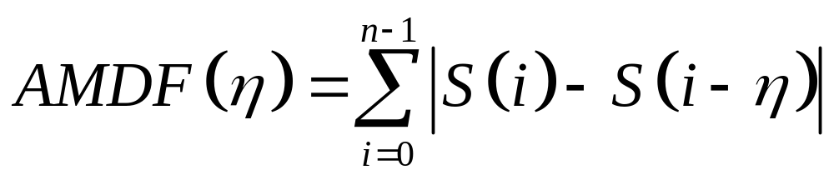

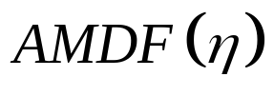
Average magnitude difference function (AMDF)
where is the time lag in terms of sample points.
The value of that minimizes over a specified range is selected as the pitch period in sample points.

Slide 9
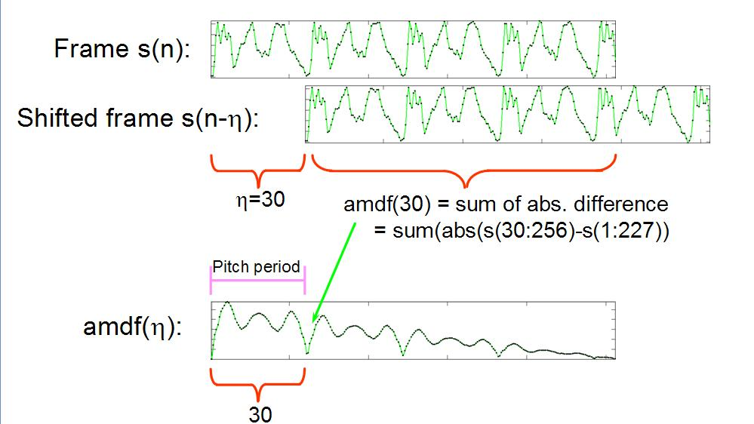

Slide 10
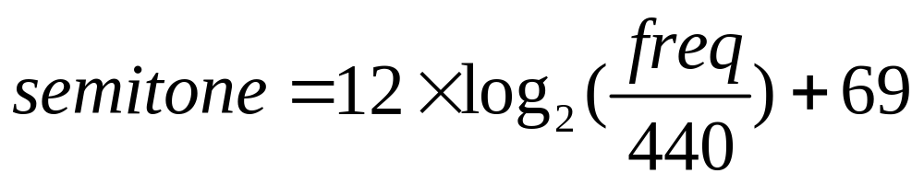
Semitone
After obtaining the pitch frequencies, we use the following formula to transform them into the representation of semitone:
The semitone representation here is equivalent to the one used by MIDI format, where 69 represents central LA (A440, 440 Hz).

Slide 11
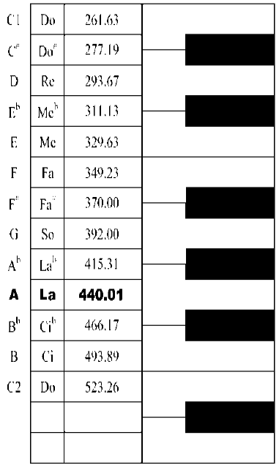

Slide 12
Pitch Smoothing
Unvoiced segments and random noise can cause unreasonably high pitch.
If the energy level is lower than a threshold, then the corresponding pitch semitones are set to zero.
Also if the identified pitch semitones are higher than 84 (or 1047 Hz in frequency), they are also set to zero.

Slide 13
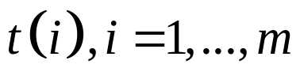

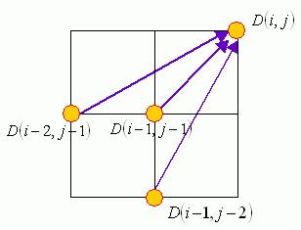
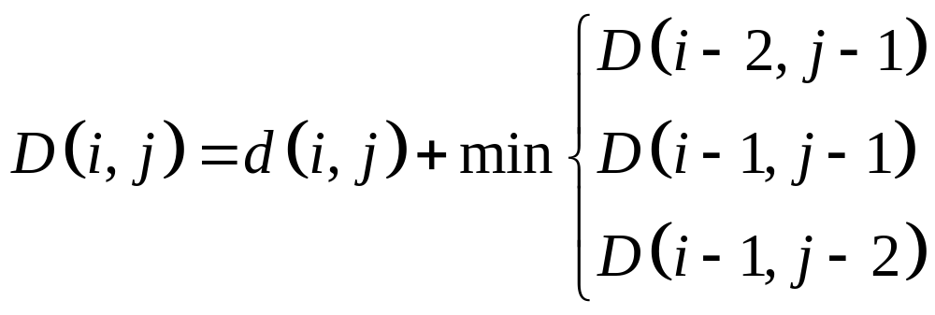
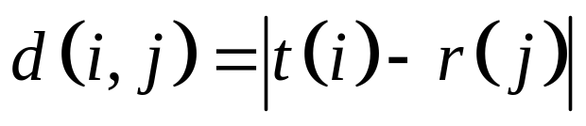
Dynamic Time Warping
input pitch vector
reference pitch vector

Slide 14
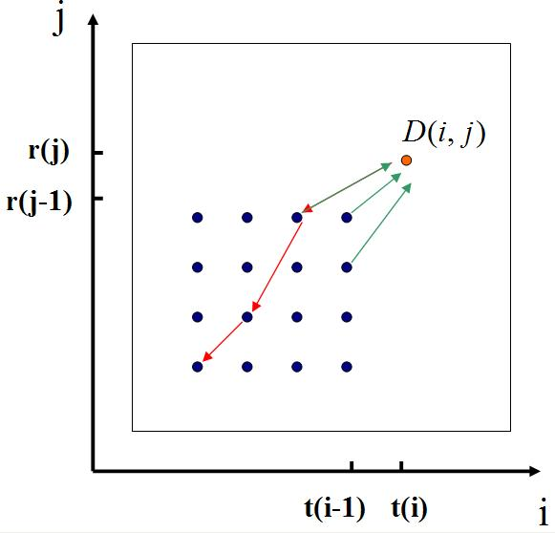

Slide 15
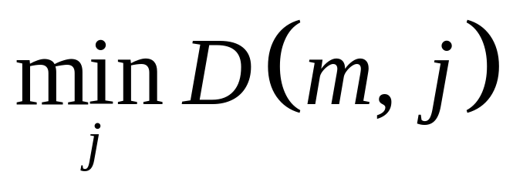
DTW
The cost of the optimal DTW path is defined as
After finding the optimizing j , we can back track to obtain the entire optimal DTW path.
.

Slide 16
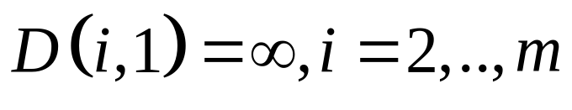
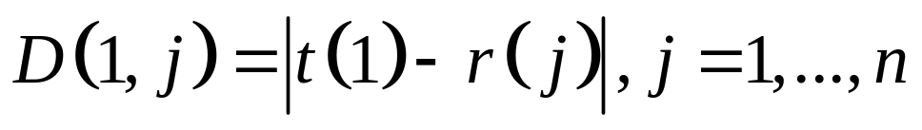
Boundary conditions
The first equation ensures that the optimal DTW path never starts from the middle of the test vector.
The second equation indicates that the optimal DTW path can start from anywhere in the middle of the reference vector.

Slide 17
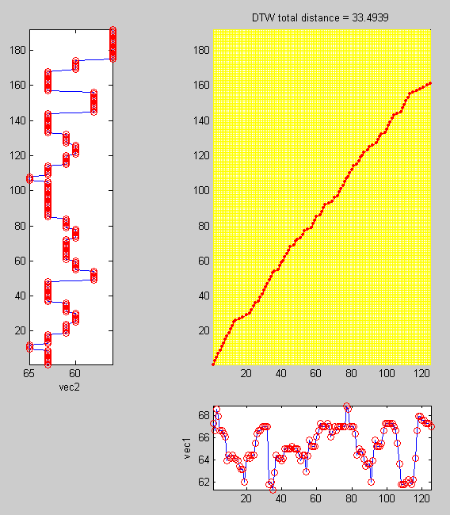
DTW Path of “Match Beginning”

Slide 18
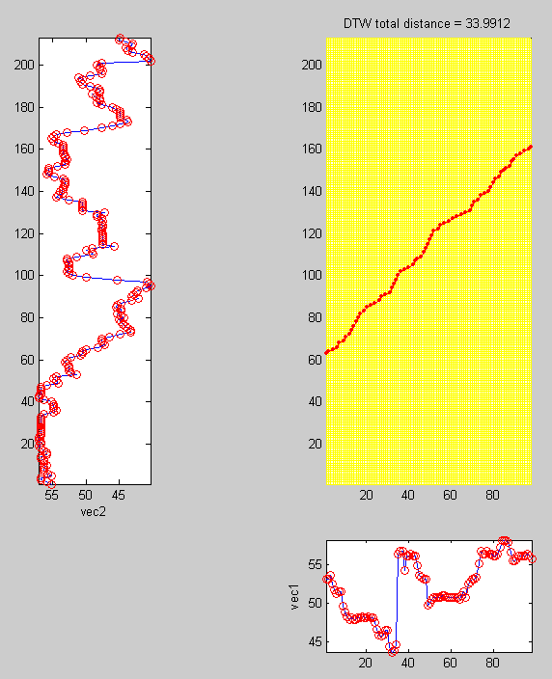
DTW Path of “Match Anywhere”

Slide 19
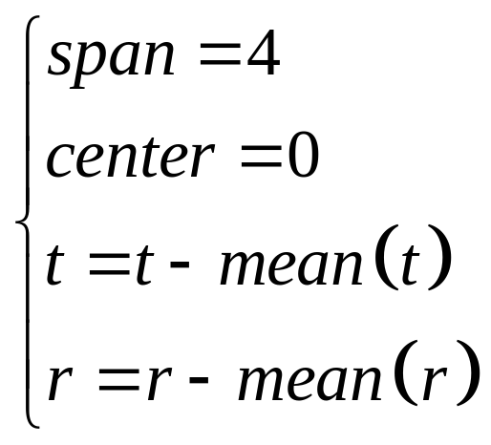


key transposition
Besides constructing the DTW table for computing each similarity scores, we still need to deal with the problem of different keys for different users.
(The last two equations make both and zero mean)

Slide 20
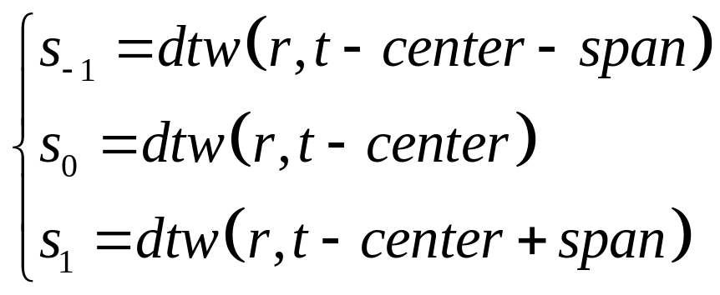


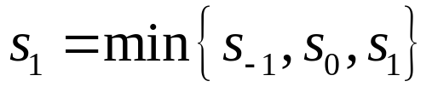


key transposition
If ,then
else if ,then
If

Slide 21
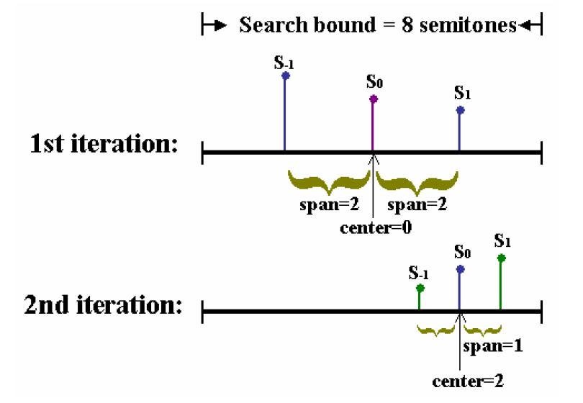





Slide 22
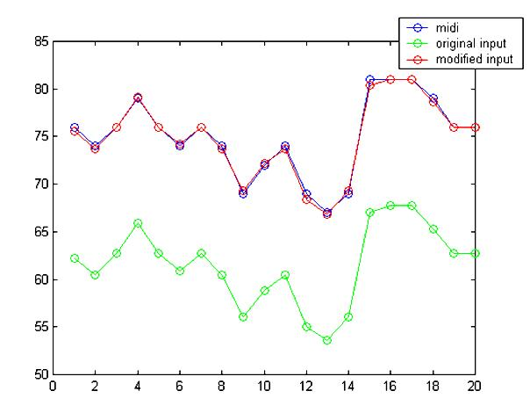
Example of Key Transposition

Slide 23
Performance Evaluation
We have around 200 recorded clips of songs sung or hummed by 14 persons (9 males, 5 females) ,each recording takes from 5 to 8 seconds.
There are about 800 songs in the database.
We divide the performance evaluation into two parts: one with the use of a single DTW for computing each similarity score, the other with the use of five DTWs to include key transposition.

Slide 24
Test of 1-DTW
The top-20 recognition rate is 84%, the top-3 recognition rate is 75%, and the top-1 recognition rate is 66%.
The average response time for each recording is about 1.557 seconds.

Slide 25
Test of 5-DTW
The top-20 recognition rate is 86.5%, the top-3 recognition rate is 84%, and the top-1 recognition rate is 76%.
The average response time for each recording is about 2.556 seconds.

Slide 26
Test of Combining 1-DTW and 5-DTW
An intuitive idea to improve the system is to take a hierarchical approach that uses 1-DTW to filter out 700 of the 800 songs, and leave only 100 songs for 5-DTW to do a detailed comparison.
The top-20 recognition rate remains 85%, the top-3 recognition rate is 83.5%, and the top-1 recognition rate is still 78%.
In other words, the performance is almost the same as that of 5-DTW, but the response time have been effectively reduced from 2.556 to 1.765 seconds.

Slide 27
Conclusions and Future Work
In this paper, a hierarchical approach for combining DTW-based comparison engines is proposed and used in a CBMR system.
Future Work

